Slide 1
Economic Analysis on Nations
By: Bodey Yaeger

Slide 2
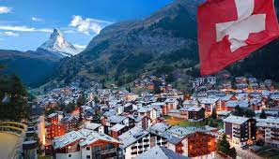

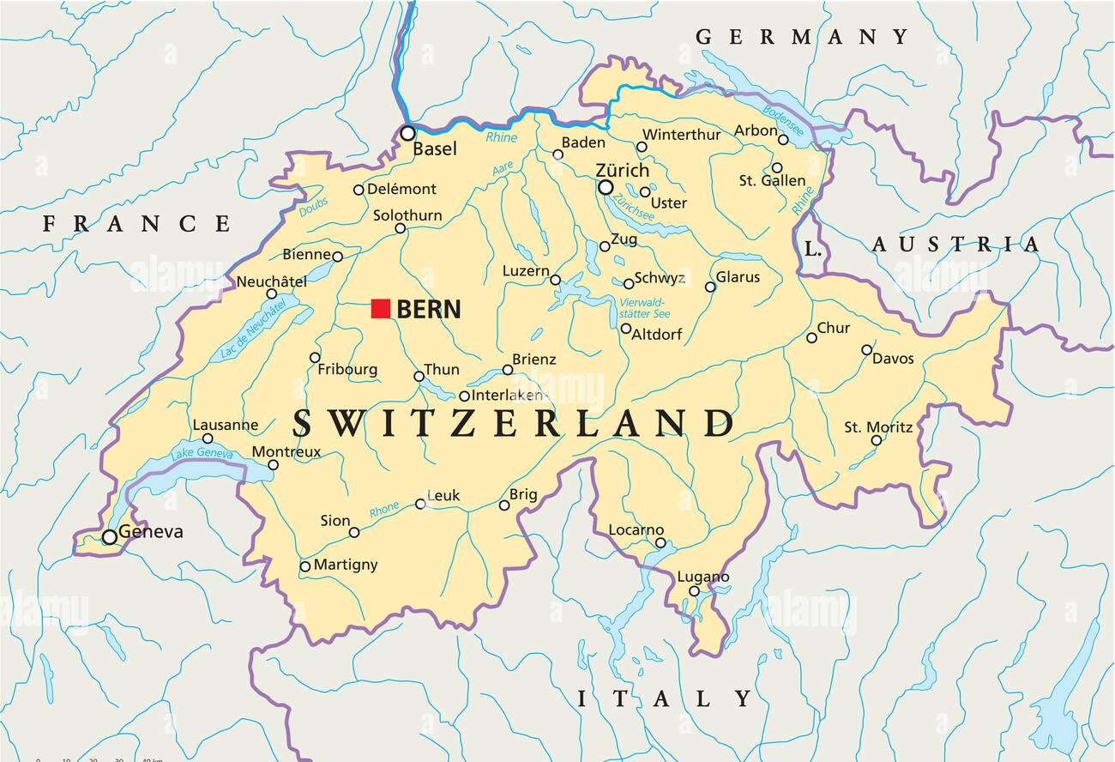
Switzerland Overview
Switzerland is located between the nations of Germany, France, Austria, and Italy.
The capital of Switzerland is Bern.
Switzerland has a population of 8.637 million (2020).
Switzerland’s most important natural resources include salt and water. They are also largely known for their good agriculture land and tourist attractions.
Notes:
Bada, F. (2019, April 29). What are the major natural resources of Switzerland? WorldAtlas. Retrieved April 20, 2022, from https://www.worldatlas.com/articles/what-are-the-major-natural-resources-of-switzerland.html

Slide 3
Switzerland Standard of Living Indicators
Per capita GDP: $68,400
Life expectancy: 83.23 years
Literacy rate: 99%
School life expectancy: 17 years
Infant mortality rate: 3.58 deaths/1,000 live births
Total fertility rate: 1.58 children born/woman (2022 est.)
Physicians density: 4.3 physicians/1,000 population (2017)
Death rate: 8.4 deaths/1,000 population (2022 est.)
Unemployment Rate: 8.6%
Notes:
Central Intelligence Agency. (n.d.). Central Intelligence Agency. Retrieved April 20, 2022, from https://www.cia.gov/the-world-factbook/countries/switzerland

Slide 4
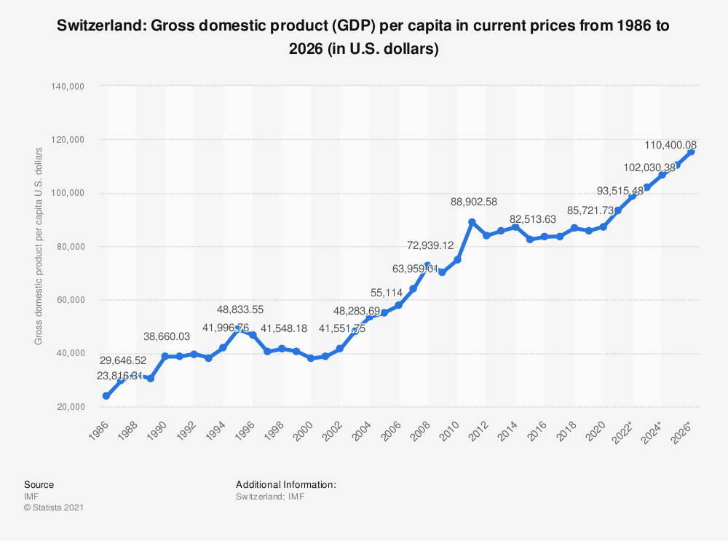
Switzerland Real Per Capita GDP
Switzerland’s real per capita GDP and projected real per capita GDP are depicted in the chart to the right. As you can see, Switzerland has seen an overall gradual increase within the past five years and is projected to steadily increase in the years following.
https://www.statista.com/statistics/261356/gross-domestic-product-gdp-per-capita-in-switzerland/

Slide 5
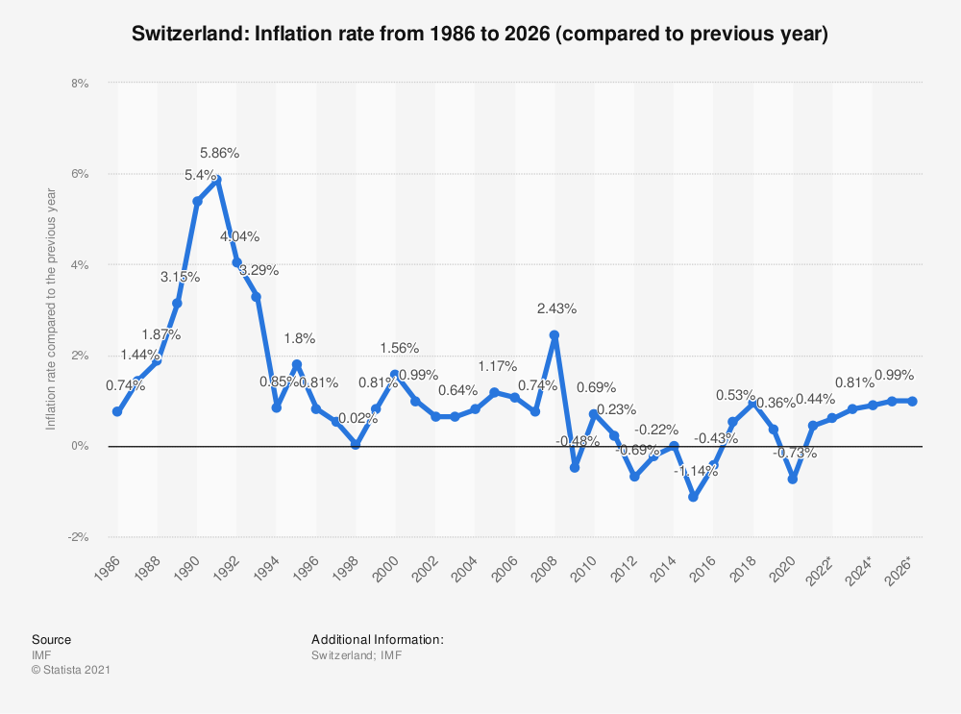
Switzerland Inflation Rate
In the graph to the right, you can see Switzerland’s inflation rate history, as well as what their projected inflation rates are for the future. As depicted, Switzerland noticed a big dip in their inflation rate in 2020. This is due to the Covid-19 pandemic.
https://www.statista.com/statistics/261381/inflation-rate-of-switzerland/

Slide 6
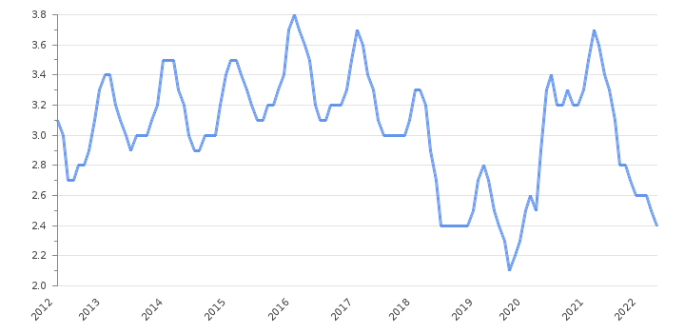
Switzerland’s Unemployment Rate
Switzerland’s Unemployment rate history up to 2022 is depicted in the graph to the right. As you can see over the past five years, the unemployment rate in Switzerland has fluctuated and been inconsistent compared to prior years. The inconsistency and large dips are largely due to the Covid-19 pandemic.
https://take-profit.org/en/statistics/unemployment-rate/switzerland/

Slide 7
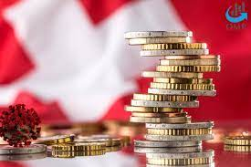
Switzerland’s Primary Determinants of Income Level
Switzerland’s economy is one of the greatest economy in the world and their wealth helps them flourish. Their three biggest determinants that contribute to their income level are their high wages, stable economy, and favorable tax rates. Furthermore, Switzerland prides itself on its banking system which also adds to its wealth.
Notes:
Maunder, S. (2022, March 25). Why is switzerland so rich? Expatica. Retrieved April 25, 2022, from https://www.expatica.com/ch/finance/investment/why-is-switzerland-so-rich-1068261/#:~:text=Switzerland%20has%20long%20attracted%20rich,rich%20residents%20come%20high%20prices.

Slide 8
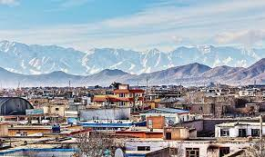

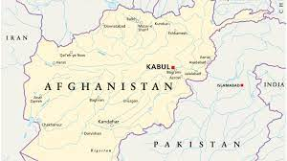
Afghanistan Overview
Afghanistan is located between the nations of Pakistan, Iran, Turkmenistan, Uzbekistan, Tajikistan, and China.
The capital of Afghanistan is Kabul.
Afghanistan has a population of 38.93 million (2020).
Afghanistan’s may not be a very rich nation in terms of income, but they are vastly resource rich. Their most important natural resources include coal, natural gas, copper, lithium, gold, iron ore, and bauxite.
Notes:
Hussain, Y. (2021, August 27). Afghanistan is a graveyard of empires, yes, but it's also a graveyard of resources. financialpost. Retrieved April 25, 2022, from https://financialpost.com/commodities/energy/afghanistan-resources-graveyard#:~:text=Despite%20its%20impoverished%20status%2C%20the,prized%20rare%2Dearth%20mineral%20reserves.

Slide 9
Afghanistan Standard of Living Indicators
Per capita GDP: $2,000
Life expectancy: 53.65 years
Literacy rate: 37.3%
School life expectancy: 10 years
Infant mortality rate: 104.89 deaths/1,000 live births
Total fertility rate: 4.62 children born/woman (2022 est.)
Physicians density: 0.28 physicians/1,000 population (2016)
Death rate: 12.33 deaths/1,000 population (2022 est.)
Unemployment Rate: 23.9% (2017 est.)
Notes:
Central Intelligence Agency. (n.d.). Central Intelligence Agency. Retrieved April 25, 2022, from https://www.cia.gov/the-world-factbook/countries/afghanistan/

Slide 10
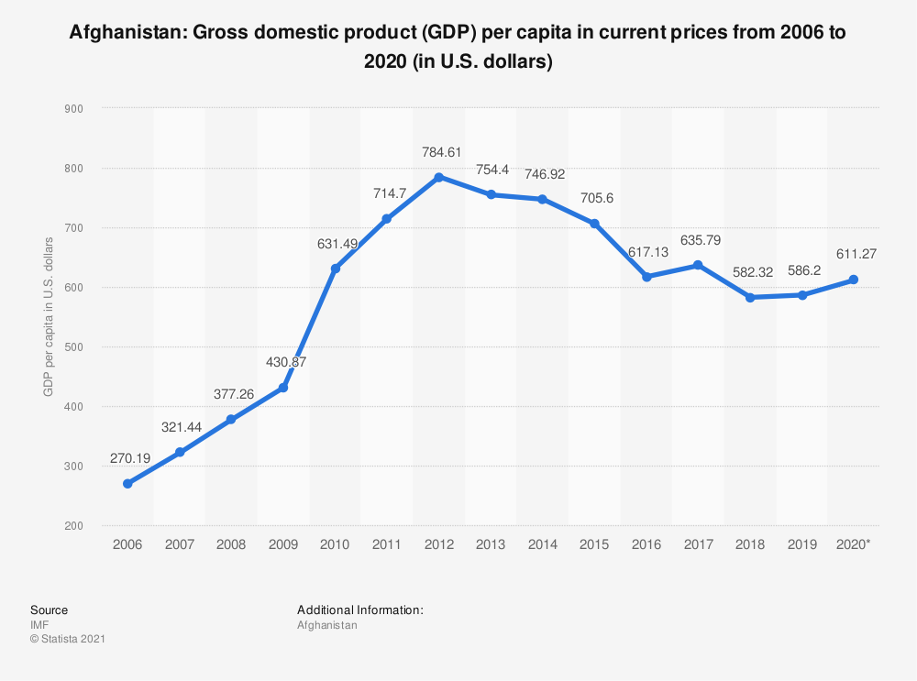
Afghanistan Real Per Capita GDP
In the graph to the right, you can see how Afghanistan’s real per capita GDP has trended over years past. From 2015 to 2020, their real per capita GDP saw primarily decreases excluding a slight increase from 2016-2017. The reason their real per capita GDP has decreased so much in prior years is due to the nations, insecurity, poverty, corruption, and weak government.
https://www.statista.com/statistics/262052/gross-domestic-product-gdp-per-capita-in-afghanistan/

Slide 11
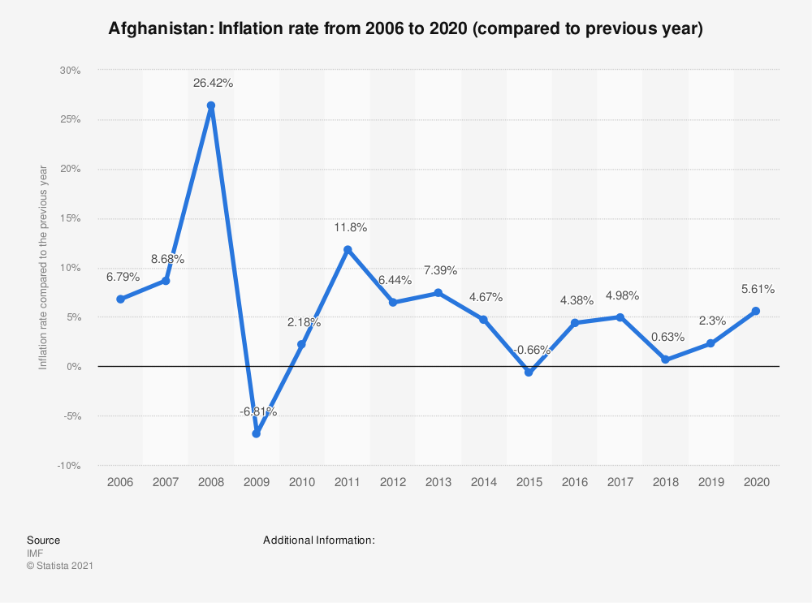
Afghanistan’s Inflation Rate
Depicted in the graph to the right is Afghanistan’s Inflation rate over recent years. Over the course of the past five years, Afghanistan has seen been steady aside from a dip in 2018. This decrease in inflation rate is due to a decrease in war spending in the year.
https://www.statista.com/statistics/262062/inflation-rate-in-afghanistan/

Slide 12
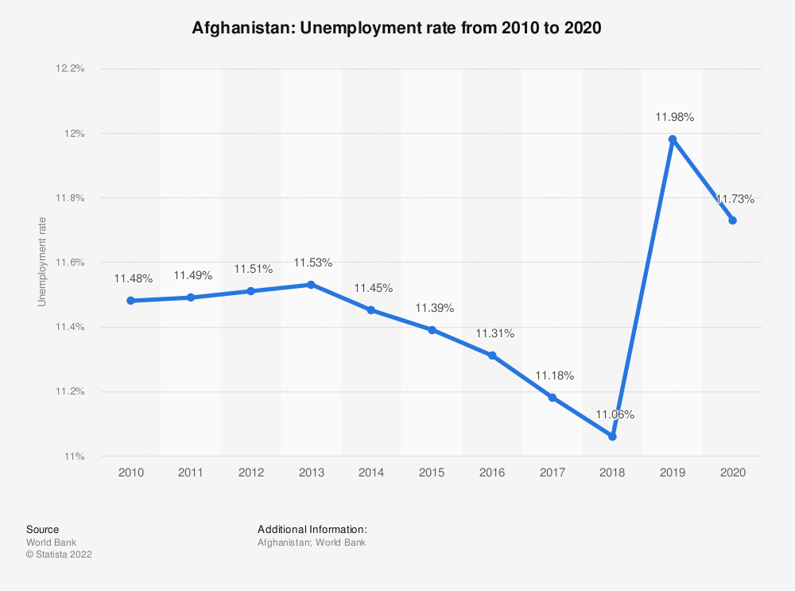
Afghanistan’s Unemployment Rate
Depicted in the graph to the right is Afghanistan’s unemployment rate history over the past 10 years. Their unemployment rate had been trending down further and further for years but saw a major spike in from 2018 to 2019. This large increase is due to job insecurity and not having enough governmental jobs.
https://www.statista.com/statistics/808214/unemployment-rate-in-afghanistan/
Notes:
TOLOnews, TOLOnews, &amp; TOLOnewsTV NetworkTOLOnews is Afghanistan’s first 24-hour TV/online news channel covering national. (n.d.). Asia's least developed country is Afghanistan: UN report. TOLOnews. Retrieved April 25, 2022, from https://tolonews.com/afghanistan/asias-least-developed-country-afghanistan-un-report

Slide 13
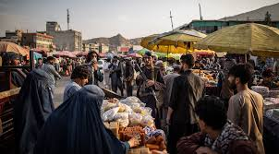
Afghanistan’s Primary Determinants of Income Level
Afghanistan is a nation riddled with corruption and this carries over to the way their economy performs. The biggest factors to Afghanistan’s low-income nation are ongoing war and conflict, lack of governmental infrastructure, and having limited access to markets. Most of if not all of the economical problems affecting Afghanistan are due to the war and historical conflict the nation has faced.
Notes:
TOLOnews, TOLOnews, & TOLOnewsTV NetworkTOLOnews is Afghanistan’s first 24-hour TV/online news channel covering national. (n.d.). Unemployment rate spikes in Afghanistan. TOLOnews. Retrieved April 25, 2022, from https://tolonews.com/afghanistan/unemployment-rate-spikes-afghanistan

Slide 14
References
Bada, F. (2019, April 29). What are the major natural resources of Switzerland? WorldAtlas. Retrieved April 20, 2022, from https://www.worldatlas.com/articles/what-are-the-major-natural-resources-of-switzerland.html
Central Intelligence Agency. (n.d.). Central Intelligence Agency. Retrieved April 20, 2022, from https://www.cia.gov/the-world-factbook/countries/switzerland
https://www.statista.com/statistics/261356/gross-domestic-product-gdp-per-capita-in-switzerland/
https://www.statista.com/statistics/261381/inflation-rate-of-switzerland/
https://take-profit.org/en/statistics/unemployment-rate/switzerland/
Maunder, S. (2022, March 25). Why is switzerland so rich? Expatica. Retrieved April 25, 2022, from https://www.expatica.com/ch/finance/investment/why-is-switzerland-so-rich-1068261/#:~:text=Switzerland%20has%20long%20attracted%20rich,rich%20residents%20come%20high%20prices.
Hussain, Y. (2021, August 27). Afghanistan is a graveyard of empires, yes, but it's also a graveyard of resources. financialpost. Retrieved April 25, 2022, from https://financialpost.com/commodities/energy/afghanistan-resources-graveyard#:~:text=Despite%20its%20impoverished%20status%2C%20the,prized%20rare%2Dearth%20mineral%20reserves.
Central Intelligence Agency. (n.d.). Central Intelligence Agency. Retrieved April 25, 2022, from https://www.cia.gov/the-world-factbook/countries/afghanistan/
https://www.statista.com/statistics/262052/gross-domestic-product-gdp-per-capita-in-afghanistan/
https://www.statista.com/statistics/262062/inflation-rate-in-afghanistan/
https://www.statista.com/statistics/808214/unemployment-rate-in-afghanistan/
TOLOnews, TOLOnews, &amp; TOLOnewsTV NetworkTOLOnews is Afghanistan’s first 24-hour TV/online news channel covering national. (n.d.). Asia's least developed country is Afghanistan: UN report. TOLOnews. Retrieved April 25, 2022, from https://tolonews.com/afghanistan/asias-least-developed-country-afghanistan-un-report
TOLOnews, TOLOnews, & TOLOnewsTV NetworkTOLOnews is Afghanistan’s first 24-hour TV/online news channel covering national. (n.d.). Unemployment rate spikes in Afghanistan. TOLOnews. Retrieved April 25, 2022, from https://tolonews.com/afghanistan/unemployment-rate-spikes-afghanistan

